Slide 1
PROTECTIONS FOR LGBTQ IN INDIA
WHERE ARE WE AFTER 2019 ??
Dr. Tanay Maiti
DNB Psych, DPM, MRCPsych (A)
Psychiatrist, AIIMS, Bhubaneswar
Fellow, Dr. R.N.M Foundation, NIMHANS
Representing: Indian institute of Sexology, Bhubaneswar

Slide 2
Objectives
To discuss the currently available legal and social protections for the LGBTQ population
To address the gap existing in reality and specify the unmet needs regarding the same.

Slide 3
Legal protection
Social protection
Occupational protection
Sexual protection

Slide 4
The British Government enacted Section 377 of the IPC, based on Victorian morality, to criminalize non-procreative sex
Unnatural offences:
Whoever voluntarily has carnal intercourse against the order of nature with any man, woman or animal, shall be punished with imprisonment for life, or with imprisonment of either description for term which may extend to ten years, and shall also be liable to fine.

Slide 5
violated the rights to privacy, to dignity and health, to equality and non- discrimination and to freedom of expression.
The NAZ Foundation

Slide 6
Delhi High Court(2nd July 2009) in a landmark judgment, held Section 377 to be violative of Articles 21, 14 and 15 of the Constitution
July, 2009, Chief Justice Ajit Prakash Shah and Justice S. Muralidhar of the Delhi High Court transformed the lives of India’s LGBT citizens by their momentous ruling in the Naz Foundation case.
The Supreme Court of India, (December 2013) upheld Section 377 and overturned the judgment of the Delhi High Court

Slide 7
Government seeks clarification from Supreme Court: Sept 11, 2014
Rights of Transgender Persons Bill (2014) moved in Rajya Sabha: MP Tiruchi Siva
Collated responses by diverse groups to the MSJE 2015 bill Private member (Tiruchi Siva) bill (2014) passed in Rajya Sabha
MSJE Transgender Rights bill (2015) bill
Lok Sabha Transgender Rights bill (2016) bill

Slide 8
In 2014, the Supreme Court of India delivered its judgment in National Legal Services Authority v. Union of India (also known as, NALSA v. UOI),
The 2014 judicial mandate stands backed by the judgments of the Supreme Court in Justice K. S. Puttaswamy (Retd.) and anr. v. Union of India and ors. (2017) and Navtej Singh Johar v. Union of India (2018)

Slide 9
Social terms/tags
Hizra
Kinnar
Aravani
Kothi
Shiv-shakthis
Jogti/Jogtas and Jogappas

Slide 10



Movies: then and now
Fire 1996
Dostana 2008
Dunno Y 2010

Slide 11
Members of LGBTQIA can find help at iCall 022-25521111
Sahay is 24X7 LGBT helpline can be reached at (toll free) 1800-2000-113
Sahodari is a helpline for transgender community, dial 76397 41916
Sahodaran works with LGBTQIA+ people in Tamil Nadu - 98418 65423 or 044 23470486
Orinam, an all-volunteer LGBTIQA+ collective based in Chennai, can be reached at 98415 57983

Slide 12
Orinam in Chennai
Diversity Dialogues in Bangalore
Humsafar Trust Mumbai

Slide 13

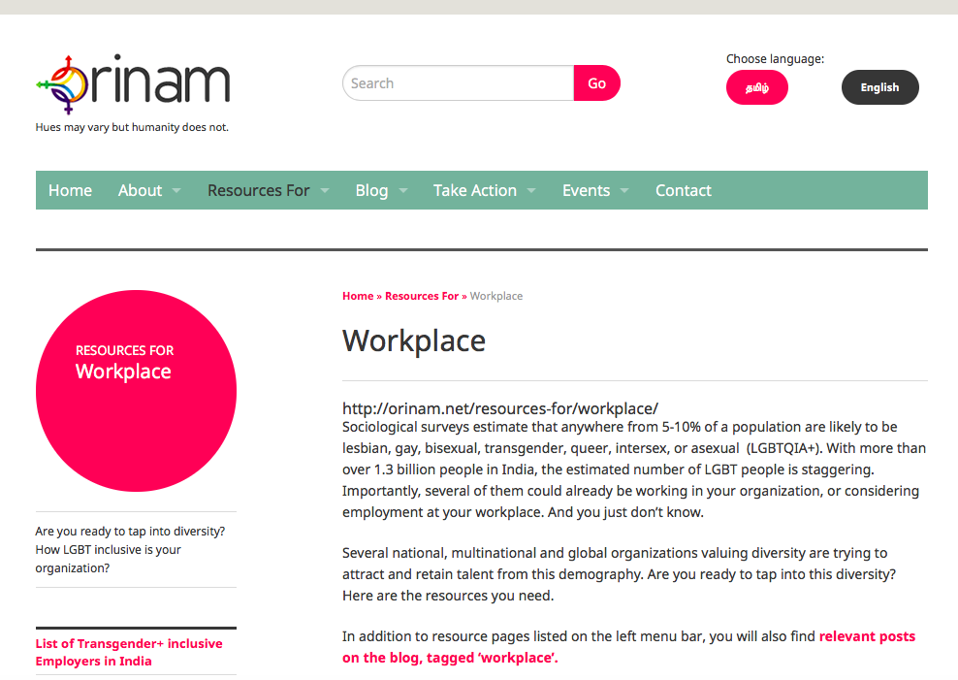
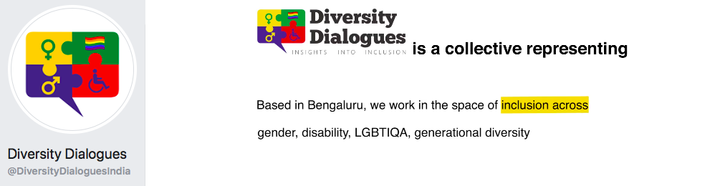

Slide 14
Occupational protection
You are safe when you are economically independent !
India’s loss in GDP due to homophobia and transphobia up to $32 billion, or 1.7% of our GDP (Radcliffe, 2016)
State based initiatives
IIM Bangalore’s QUEst; Google, Facebook and Youtube introduced rainbow pride colours
Gap in pink tourism

Slide 15


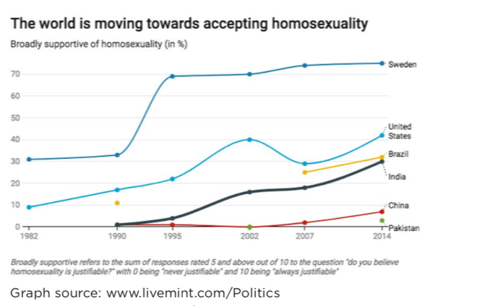

Slide 16
Work at state levels
Tamil Nadu
• Free registration of lands and ration cards
• Offers soft loans
• Vocational training
• Free health insurance
• The first state in India, transgender welfare board(2008)

Slide 17
Kerala
• By 2017, both Cochin and Trivandrum had welfare boards.
• Formed a state Transgender Cell for skilling and training
• Issues ID cards( committee headed by the District Collector)
• Offered scholarships for school and higher education
• The University of Kerala has a trans policy
• Teachers have been trained and sensitized( more than 2000 schools)
• Kochi Metro Rail Limited (KMRL) : in housekeeping, customer care and crowd management

Slide 18
Karnataka
Akkai Padmashali’ ‘Ondede’ has also joined hands with
the Election Commission (EC) in conducting awareness programs for the transgender community
• Offered a pension scheme for trans individuals from the ages 18 to 64

Slide 19
Odisha
• Issue of BPL cards and free housing schemes
• Provided 100 days of paid work annually
• Entitled to 5kg of food grains under India’s National Food Security Act
• Pensions and loans to start up businesses

Slide 20
Chhattisgarh
• Eleven departments i.e. Health, Higher Education, Women & Child Development, Social Welfare, Technical Education, School Education, Home, Panchayat and Rural Development, Urban Development, Public Relations and General Administration have announced schemes or activities specifically for the community
• class 8-10 have introduced chapters, so as to sensitize students, parents as well as teachers
• healthcare provision Thursday OPD in medical colleges and hospitals
• 2% reservation for housing schemes through Indira Awas Yojana
• Free SRS to be provided in government hospitals

Slide 21
What are Sexual Rights?
XV World Congress of Sexology,
Declaration of Sexual Rights, establishing that
“Sexual rights are universal human rights based on the inherent freedom, dignity and equality of all human beings”
Since health is a fundamental human right, so must sexual health be a basic human right
recognize, promote, respect and defend the rights to sexual freedom and sexual autonomy.”
Source: World Association of Sexology. 1999. Declaration of Sexual Rights. Available at www.worldsexology.org.

Slide 22
sexual rights as the rights of all
to make choices based on consent on who their partners are, what kind of sex they want to engage in, and every other issue regarding their sexuality
to have or not have sex in all contexts including marriage and paid sex
to have sex with one or more people simultaneously if all involved consent to it
to marry or not to marry
to play, discover, have fun with one’s sexuality

Slide 23
to sell and buy sex
to differ on the issue of sex
to advertise sexual services
to produce, use and advertise sex objects, and sexually explicit materials
to express oneself without discrimination because one is different
to live a life free of coercion, violation, discrimination based on sexual identity and practices
to experience the unfettered practice of one’s sexuality in all spheres of activity except sexual abuse
to enjoy a positive and affirmative sexuality

Slide 24
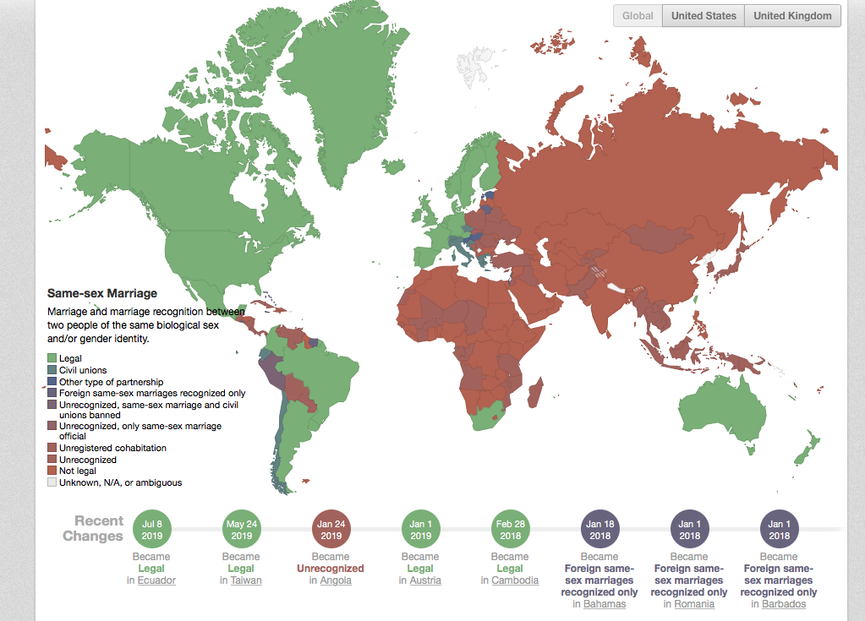

Slide 25
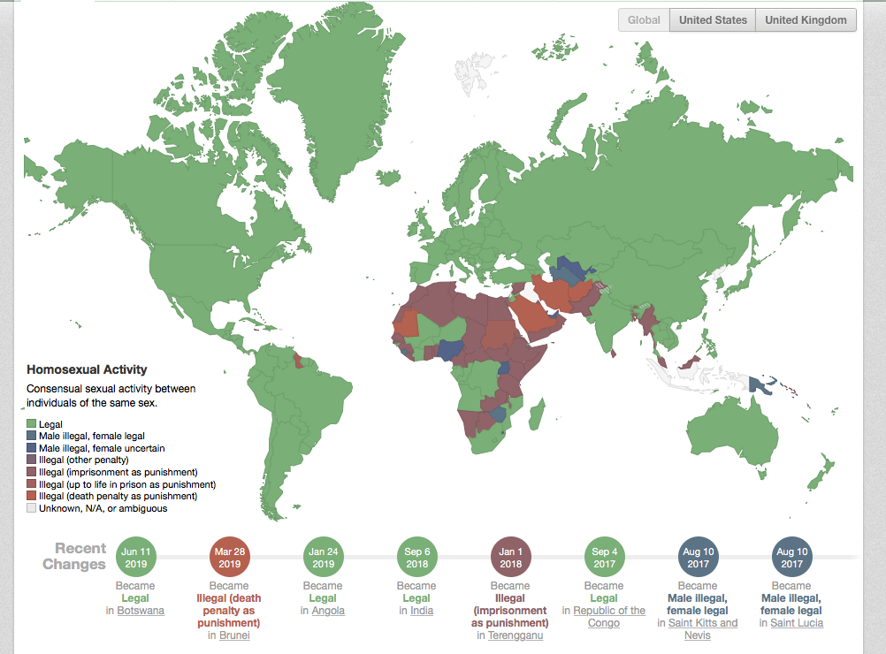

Slide 26

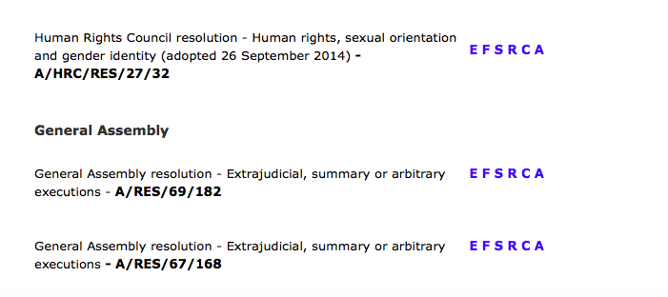

Slide 27
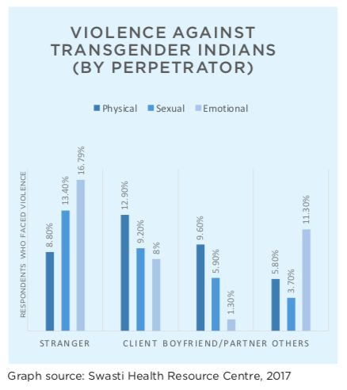
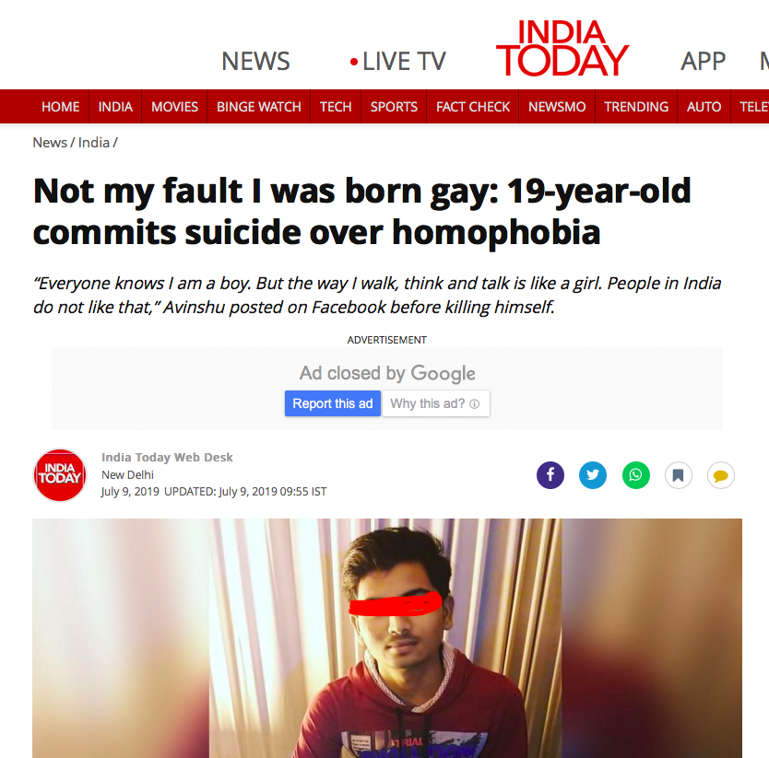

Slide 28
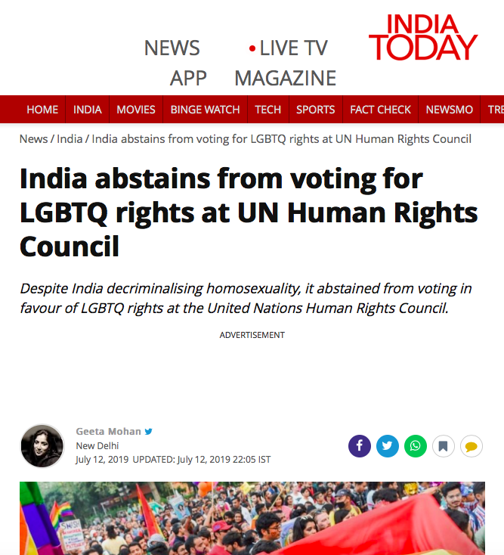

Slide 29
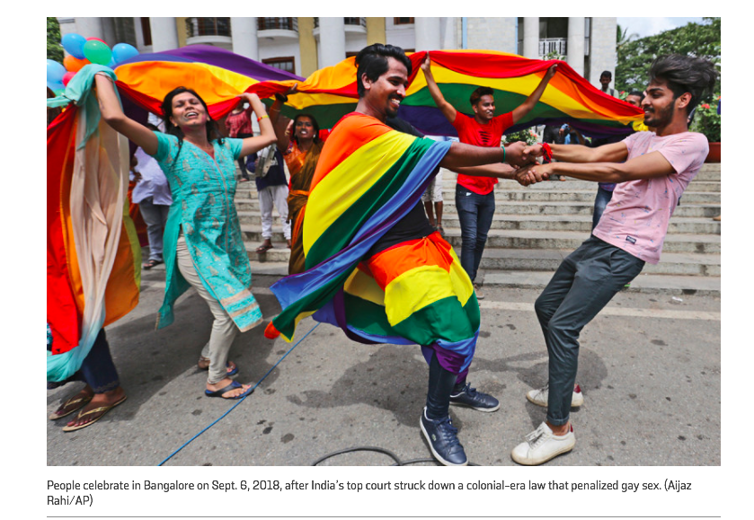

Slide 30

THANK YOU

